Slide 1
4. POINTER

Slide 2
Nilai variable x
int x = 5;
Printf(" %d ", x);
Printf(" %x ", &x);
Output : 5
Output : 62fe1c
address variable x

Slide 3
RAM
Address | content
. . . | . . .
62fe1c | 5
. . . | . . .
int x = 5;

Slide 4
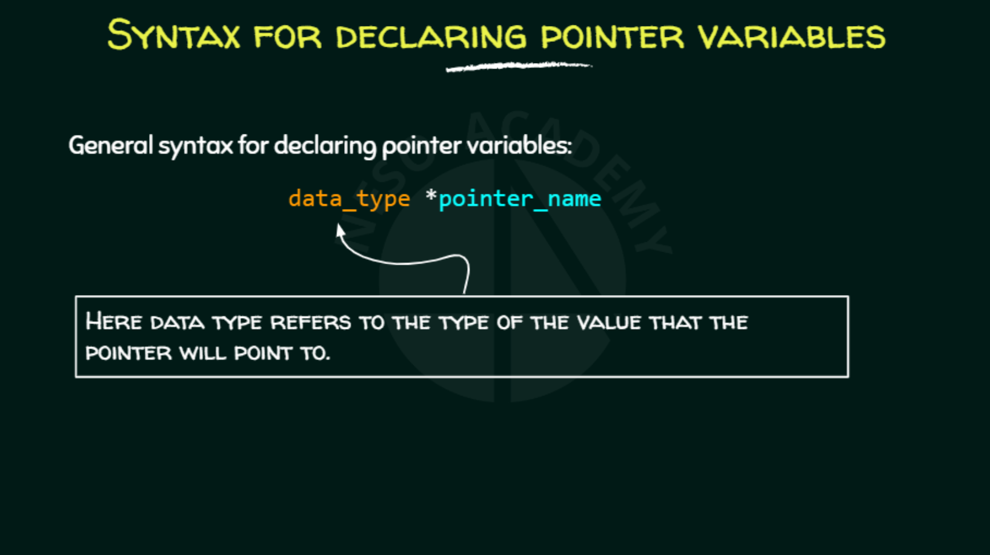
RAM
Address | content
. . . | . . .
62fe1c | 5
. . . | . . .

Slide 5
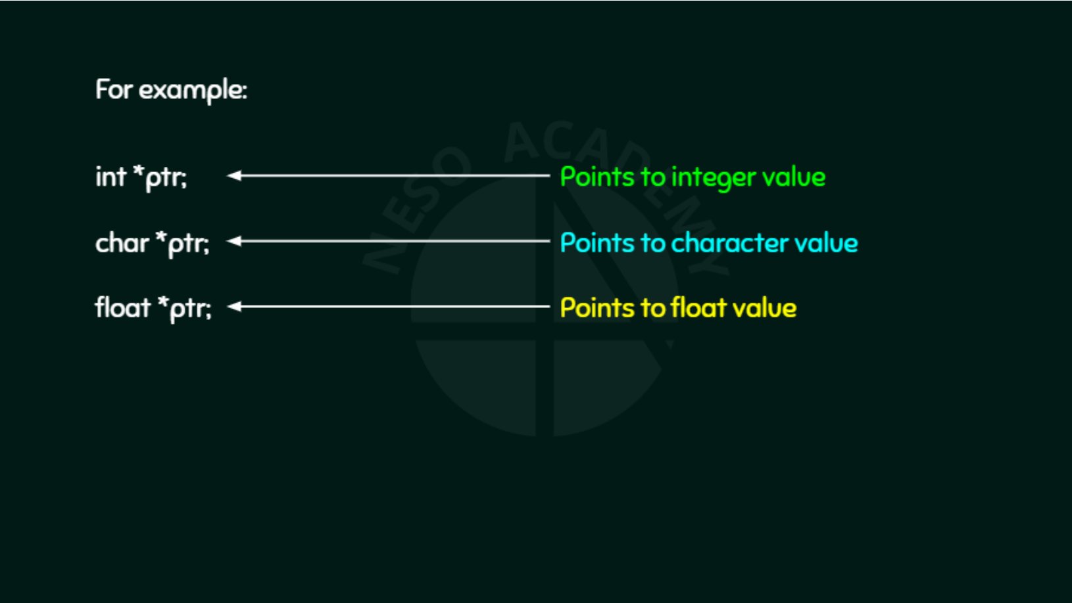
RAM
Address | content
. . . | . . .
62fe1c | 5
. . . | . . .

Slide 6

RAM
Address | content
. . . | . . .
62fe1c | 5
. . . | . . .

Slide 7
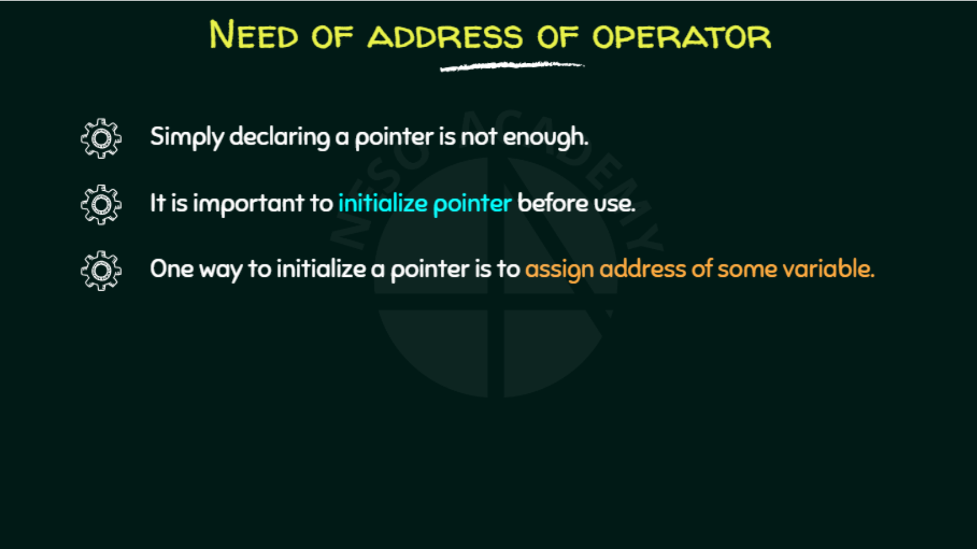
RAM
Address | content
. . . | . . .
62fe1c | 5
. . . | . . .

Slide 8
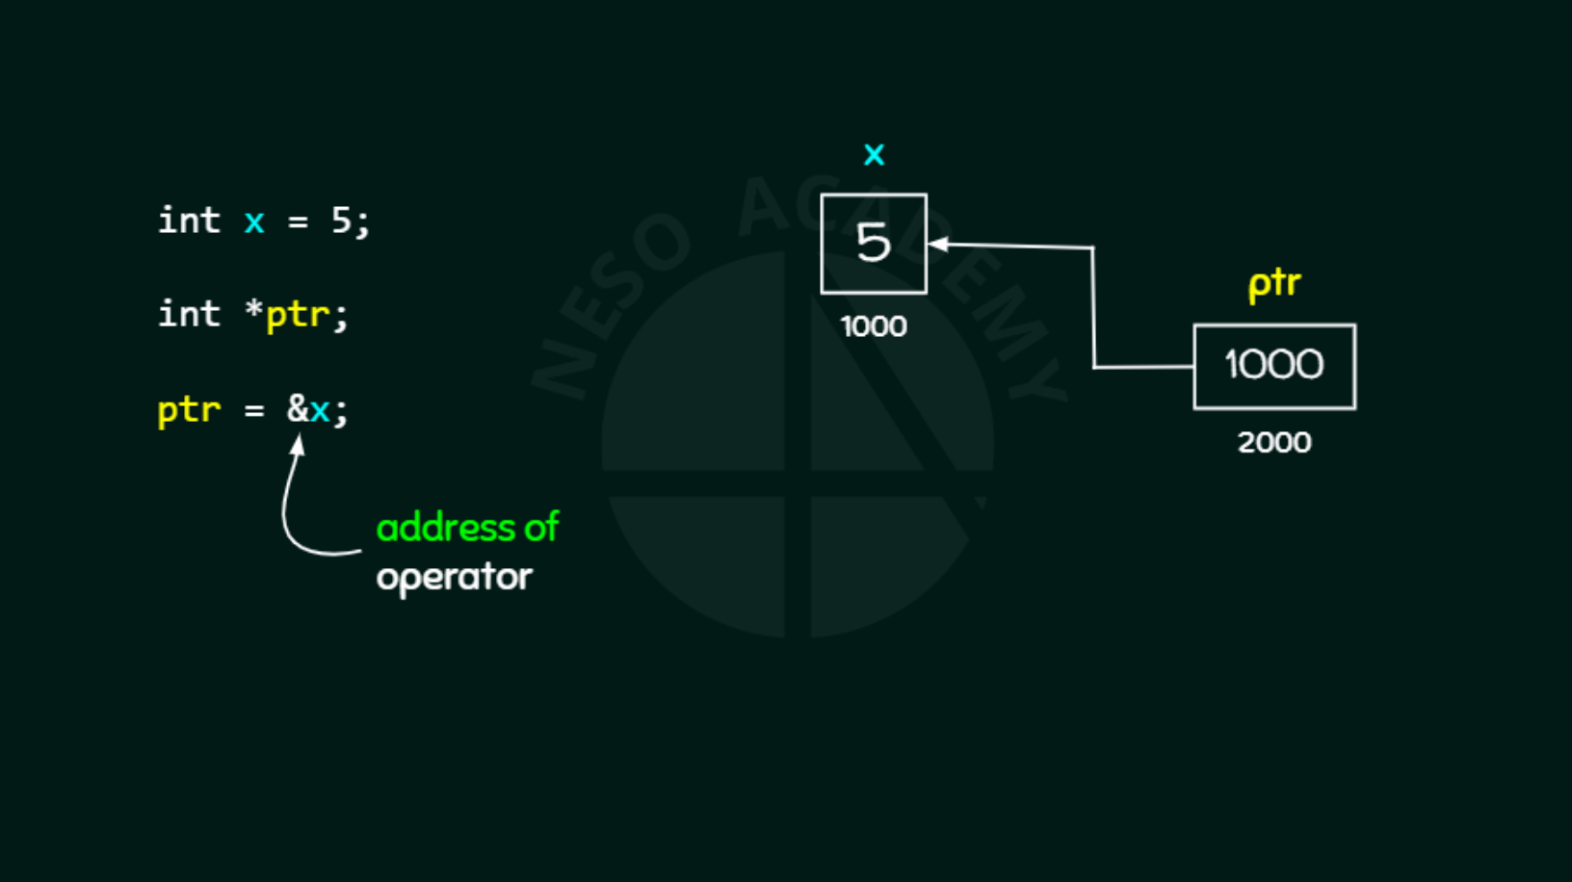
RAM
Address | content
. . . | . . .
62fe1c | 5
. . . | . . .

Slide 9

RAM
Address | content
. . . | . . .
62fe1c | 5
. . . | . . .

Slide 10
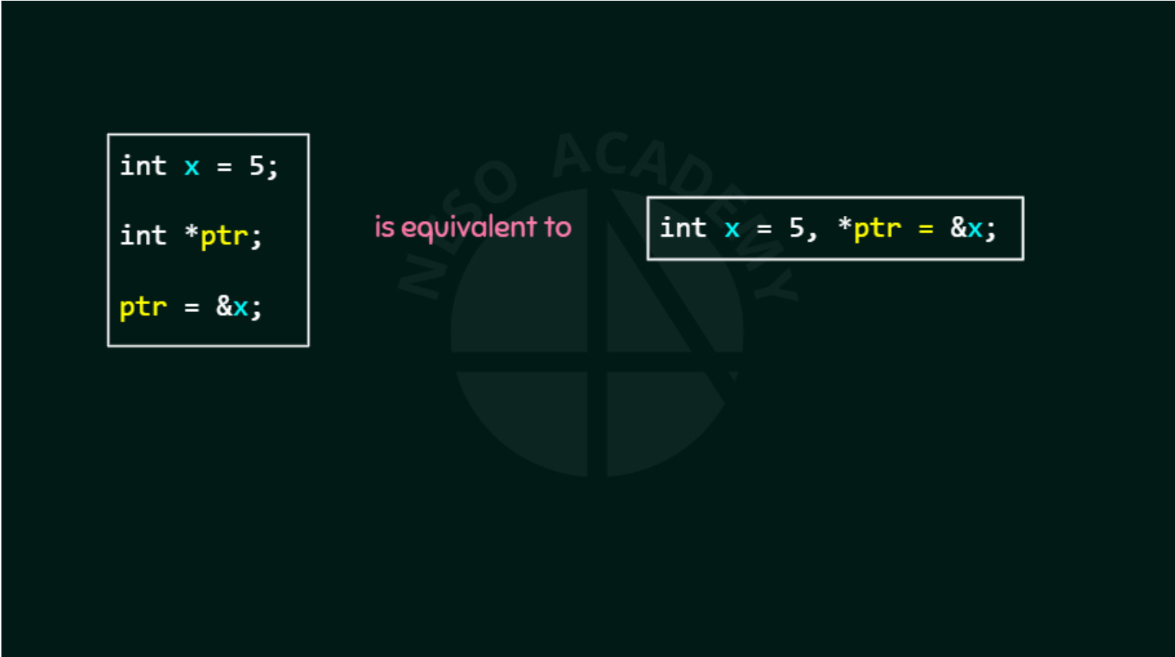
RAM
Address | content
. . . | . . .
62fe1c | 5
. . . | . . .

Slide 11
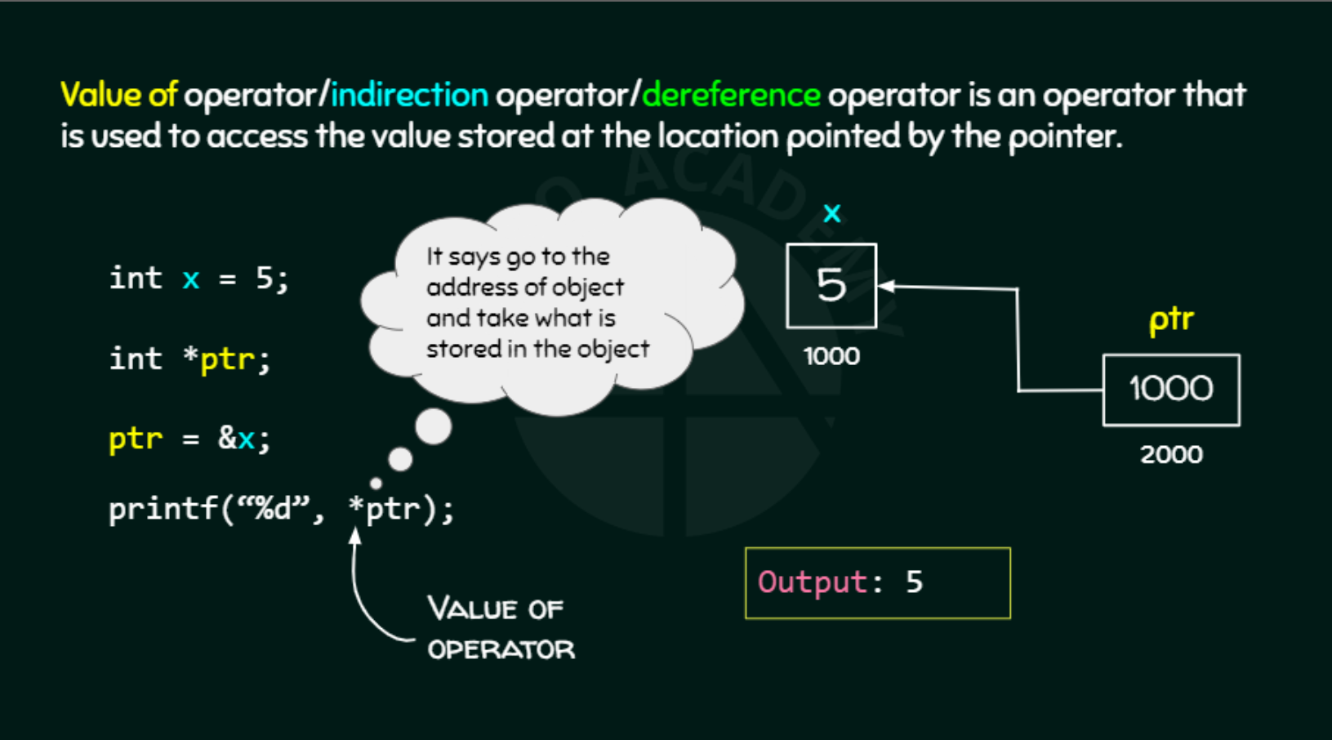
RAM
Address | content
. . . | . . .
62fe1c | 5
. . . | . . .

Slide 12
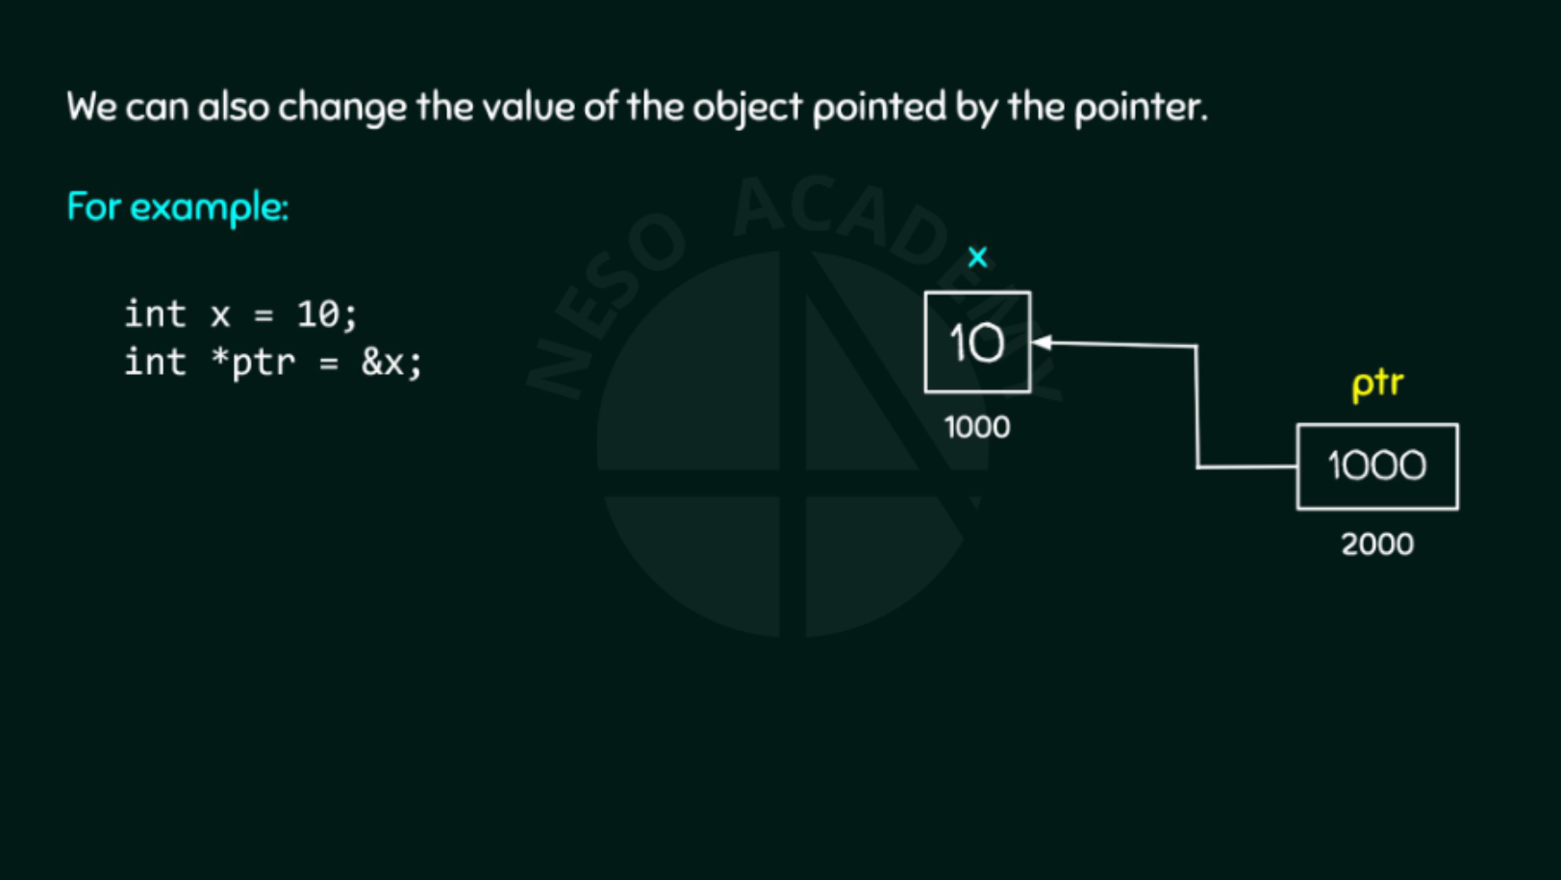
RAM
Address | content
. . . | . . .
62fe1c | 5
. . . | . . .

Slide 13
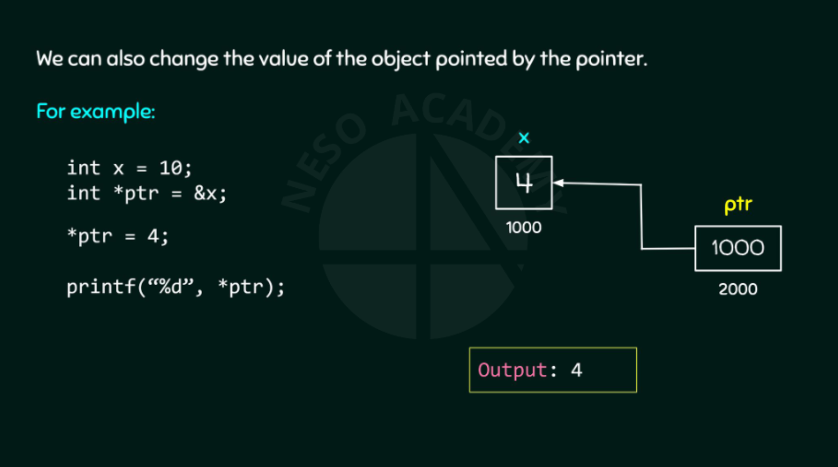
RAM

Slide 14
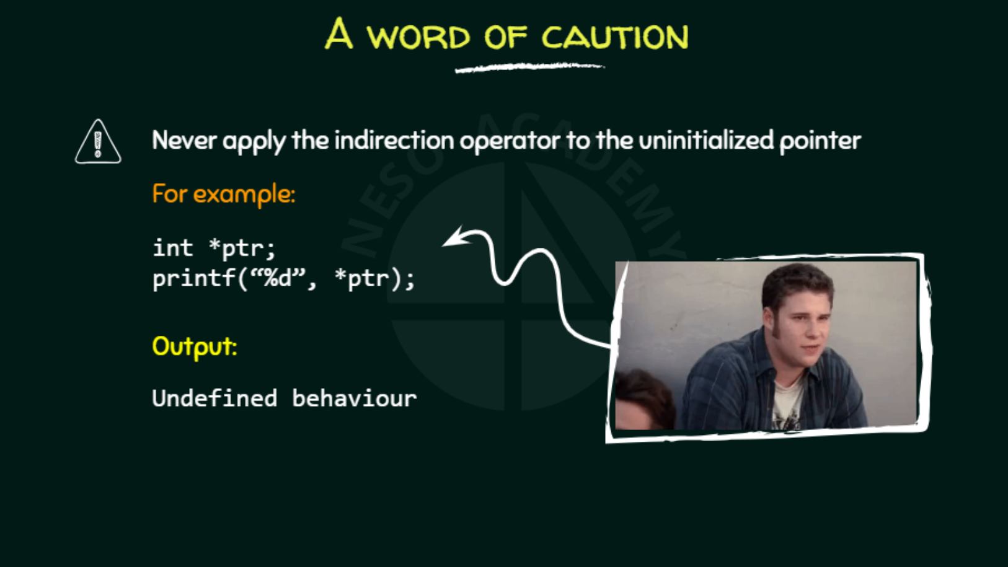

Slide 15
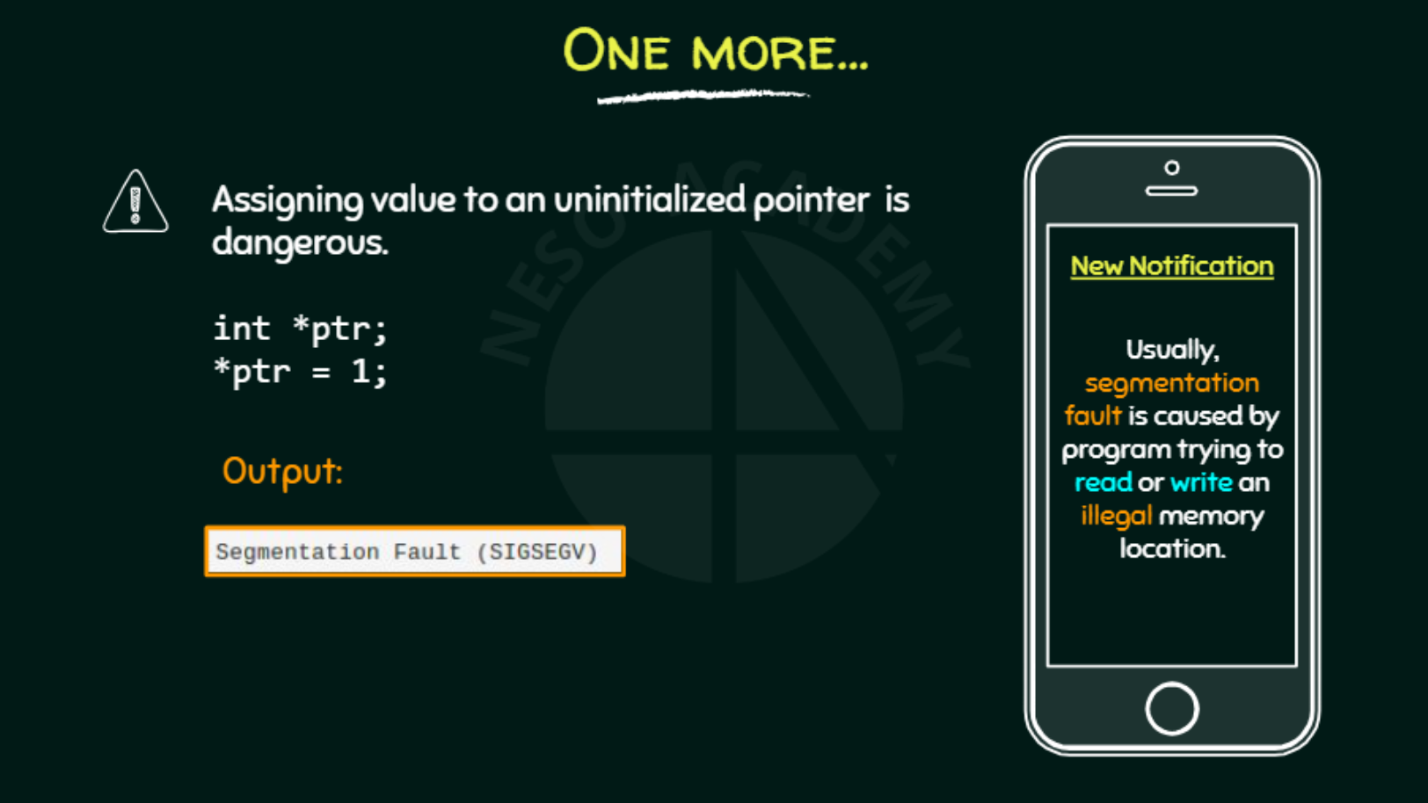

Slide 16
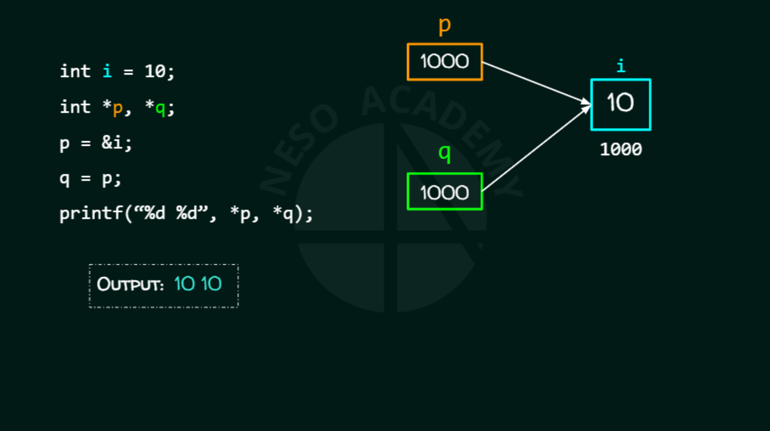

Slide 17
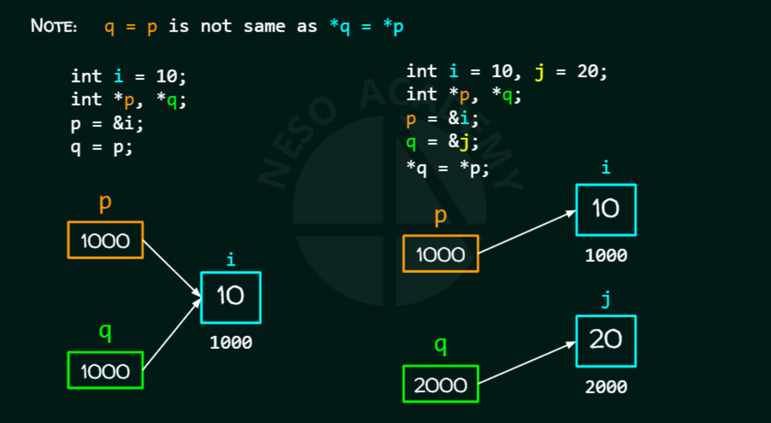

Slide 18
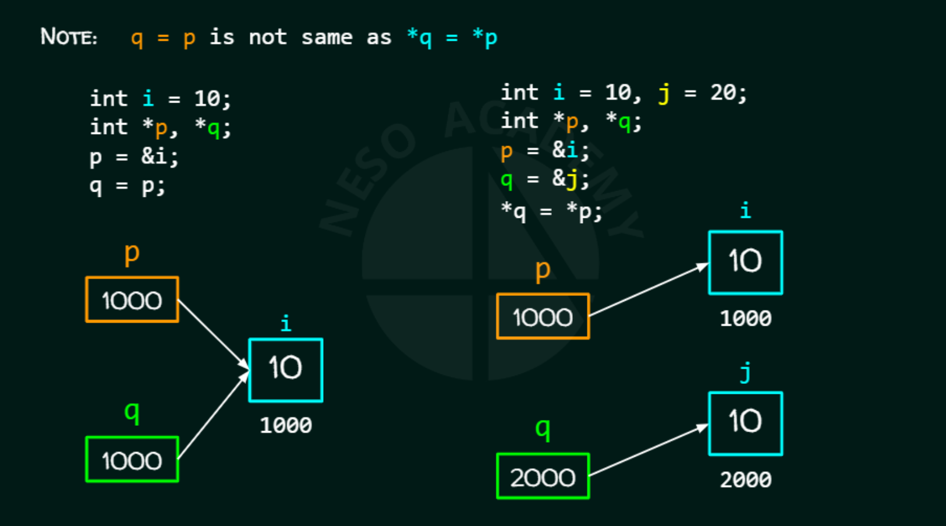

Slide 19
